Slide 1
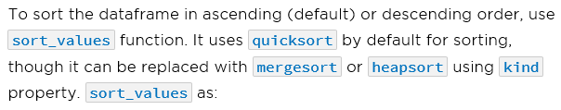
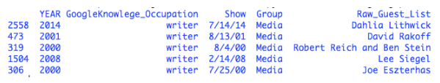
Data Manipulation
Data manipulation includes sorting, merging, grouping, and altering the data. Pandas offers multiple functions to manipulate data as:
1. Sorting
sorted_guest_df = guest_list_df.sort_values('GoogleKnowlege_Occupation', # sort by column
ascending=False, # enable descending order
kind='heapsort', #sorting algorithm
na_position='last') # keep NaN value at last

Slide 2

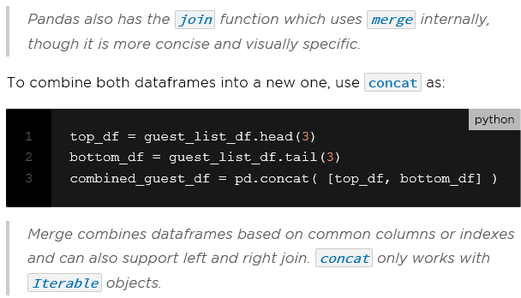
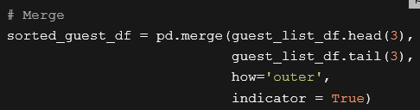
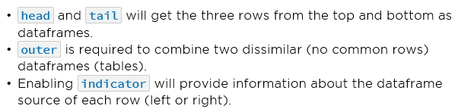
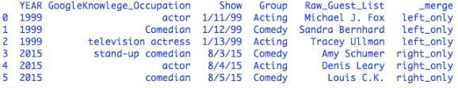
2. Merge and Concatenation

Slide 3
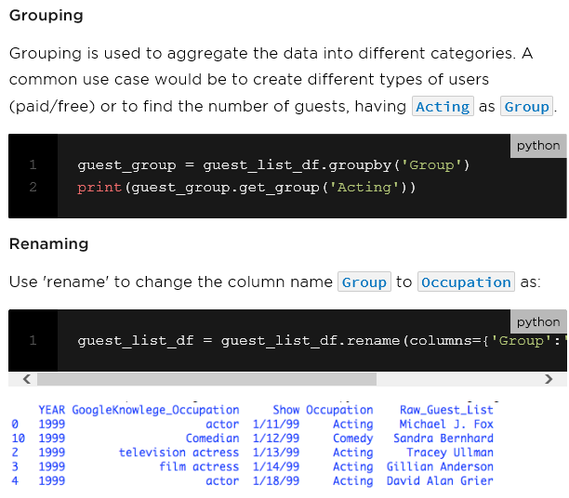
3. Grouping
4. Renaming

